Slide 1


ATTENDENCE LOGGING SYSTEM

Slide 2
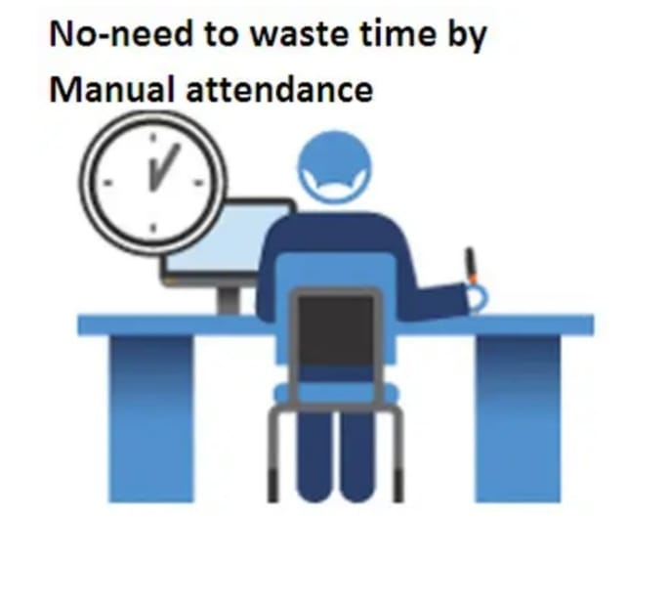
INTRODUCTION
Attendance Management System is used to maintain student attendance records.
It helps in storing student details like name and PRN number.
The system is developed using C programming language.
Attendance can be marked as present or absent easily.

Slide 3
It calculates the overall attendance percentage automatically.
This system saves time and reduces manual work.
It is easy to use and understand.

Slide 4

OBJECTIVES
To maintain daily attendance of students.To store student attendance details securely.
To reduce paperwork and manual errors.
To calculate attendance percentage accurately.
To help staff manage attendance efficiently.
To generate attendance reports for evaluation.

Slide 5

PROGRAM REQUIREMENTS:
Structures
File handling functions
Loops

Slide 6
FILE HANDLING FUNCTIONS:
fopen():
fwrite():
fread():
fclose():
fseek():

Slide 7
fopen():
fopen("attendance.dat", "ab")Used in the addStudent() function."ab" mode allows adding new student records without deleting old data.This is why newly entered students are saved continuously.
fwrite():
fwrite(&s, sizeof(s), 1, fp)Used to write the student structure into the file.Stores roll number, name, and attendance together as one record.fopen("attendance.dat", "rb+")Used in the markAttendance() function."rb+" mode allows the program to read and update attendance.Needed because attendance value is modified after searching the student.

Slide 8
fclose():
fclose(fp)Used after every file operation.Ensures data is saved properly and file is closed safely.Why These File Functions Are Necessary in This CodeTo save student data permanently.To search and update attendance records.To avoid losing data when the program ends.
fread():
fread(&s, sizeof(s), 1, fp)Used inside a loop to read each student record one by one.Helps the program find the student using roll number.fseek(fp, -sizeof(s), SEEK_CUR)Moves the file pointer back to the correct position.Allows the program to update attendance of the same student record.

Slide 9
fseek():
fseek(fp, -sizeof(s), SEEK_CUR)Moves the file pointer back to the correct position.Allows the program to update attendance of the same student record.

Slide 10

THANK YOU!!
G.AVANASH
ROLL NO:25A31A04H0
G.HARI PRASAD
ROLL.NO: 25A31A04H1
MADE BY:
K.ISWARYA
ROLL .NO: 25A31A04D9
K. VENKATA LAKSHMI
ROLL .NO:25A31A04E0

